Slide 1
CS 4530: Fundamentals of Software Engineering Lesson 2.5 Testing Integrated Software Systems
Rob Simmons
Khoury College of Computer Sciences

Slide 2
Software interacts with an environment
Network, Time, Randomness
The SUT
Mo
Human User
Database
2

Slide 3
Remove unnecessary parts of environment
Tests replace user interaction
Network, Time, Randomness
The SUT
Mo
Database

Slide 4
Test the appropriate connection points
Tests replace user interaction
The SUT
describe('GET /api/user/:id', () => {
it('should 404 for nonexistent users', async () => {
response = await supertest(app).get(`/api/user/${randomUUID().toString()}`);
expect(response.status).toBe(404);
expect(response.body).toStrictEqual({ error: 'User not found' });
});
it('should return existing users', async () => {
response = await supertest(app).get(`/api/user/user1`);
expect(response.status).toBe(200);
expect(response.body).toStrictEqual({ ...user1, createdAt: expect.anything() });

Slide 5
Test the appropriate connection points
Tests replace user interaction
The SUT
Controller
Service
Repository
describe('GET /api/user/:id', () => {
it('should 404 for nonexistent users', async () => {
response = await supertest(app).get(`/api/user/${randomUUID().toString()}`);
expect(response.status).toBe(404);
expect(response.body).toStrictEqual({ error: 'User not found' });
});
it('should return existing users', async () => {
response = await supertest(app).get(`/api/user/user1`);
expect(response.status).toBe(200);
expect(response.body).toStrictEqual({ ...user1, createdAt: expect.anything() });

Slide 6
Test the appropriate connection points
The SUT
Tests replace service-layer interaction
Controller
Service
Repository
describe('enforceAuth', () => {
it('should return a user and id on good auth', async () => {
const user = await enforceAuth({ username: 'user1', password: 'pwd1' });
expect(user).toStrictEqual({
_id: expect.any(Types.ObjectId),
username: 'user1’,
});
});
it('should raise on bad auth', async () => {
await expect(

Slide 7
Test the appropriate connection points
Tests replace service-layer interaction
Controller
Network, Time, Randomness
Service
Repository
Mo
Database

Slide 8
Control easy-to-control parts of environment
Tests replace service-layer interaction
Controller
Network, Time, Randomness
Service
Repository
Mo
beforeAll(async () => {
mongo = await MongoMemoryServer.create();
const uri = mongo.getUri();
await connect(uri);
});
beforeEach(async () => {
await populateMongo();
});
afterEach(async () => {
await clearMongo();
});
afterAll(async () => {
if (mongo) {
await disconnect();
await mongo.stop();
}
});
In-memory database, resets after each test
Notes:
The fact that the in-memory database was easy-to-control doesn’t come for free! It’s the result of good design decisions made by the creators of mongoose, and of the way the app internally chose to handle example data, abstracting it away into a single easy-to-access populateMongo call. But this centralization of things for the purpose of testing may have costs w.r.t how easy the app is to grow and extend later!

Slide 9
Hijack hard-to-control parts of environment
Tests replace service-layer interaction
Controller
Network, Time, Randomness
Service
Repository
Mo
In-memory database, resets after each test

Slide 10
Break for live coding

Slide 11
Test Doubles
The in-memory Mongo database is a test double for a production database that doesn’t die when you restart the server
Supertest is a test double for HTTP server architecture
Pre-determined coin flip is the test double for the random coin flip
The spied-on coin flip is the test double for the not-spied-on coin flip, kinda?
Terminology (mocks, spies, stubs, fakes, dummies) is an inconsistent mess, though many individuals have described consistent and useful categorizations

Slide 12
Test Doubles Have Weaknesses
Some failures may occur purely at the integration between components:
The test may assume wrong behavior (wrongly encoded by mock)
Higher fidelity mocks can help, but still just a snapshot of the real world
Test doubles can be brittle:
Spies expect a particular usage of the test double;
The test is "brittle" because it depends on internal behavior of SUT;
Potential maintenance burden: as SUT evolves, mocks must evolve.
Did we correctly model the behavior of httpbin?
Not just its IO behavior, but also its dependencies
Notes:
<read slide>

Slide 13
Break for more live coding

Slide 14
What’s the endgame here?
We want to be able to get the system under test as small as possible
Fast (to write and to run and to understand)
Independent from other parts of the system (unit test failures pinpoint where the error is)
Can help improve coverage (but beware the code that’s only ever run in tests…)
The endgame is unit testing

Slide 15
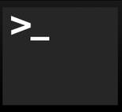

But some bugs are observable only when multiple components interact.
These are usually because one module has made incorrect assumptions about some other module
Unit tests won’t reveal such bugs
Mocks won’t help, either (since they may incorporate our incorrect assumptions)
So you really need integration tests
Integration
Unit
Mork
1 program running on 1 server
1 class of 1 program running on 1 server
Notes:
So far, our focus has been on writing on unit tests, which focus on a single module or class.
Many bugs may be observable only when multiple components interact (often as a result of one making an incorrect assumption about the others’ behavior).
To find these bugs, we may need to create bigger tests. These are generally called integration tests.

Slide 16

Integration tests may be larger, even enormous
Does the presence of other jobs on our server change the behavior of our program?
Does the presence of the other servers change the behavior of our program?
Integration
Unit
1 web server in a cluster of 100,000 servers
Mork
1 class of 1 program running on 1 server
1 program running on 1 server
Integration
Unit
Mork
1 Google product in the entire Google ecosystem
1 web server in a cluster of 100,000
1 process running on a web server
1 class of one program running on a web server
Notes:
For instance, our SUT might actually consist of multiple processes running in coordination on a single server.
Or maybe we need to worry about what happens when we run it on a live server, running alongside other servers in a cluster of 100’s of thousands of servers.
Or, maybe our focus is on testing the end-to-end behavior of an entire product, which is composed of many classes running in many processes on many servers. As you can see, the scope of integration tests can grow enormously.
Writing good end-to-end tests can be much more complex than writing unit or integration-level tests, because they need to set up much more state and interact with more external systems than a unit or integration test.
You can consider writing integration tests using Jest.

Slide 17
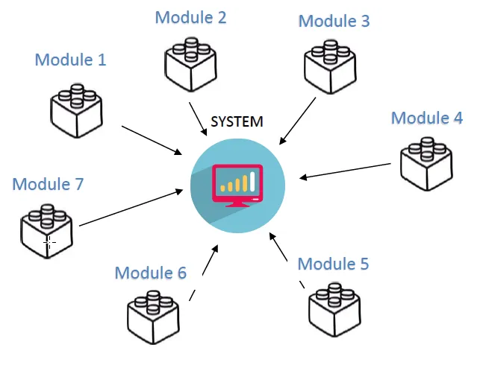
Integration tests can be done in many ways
All at once ("Big Bang")
Top-down
Bottom-up
Middle-out
Top-Bottom-Middle
etc., etc., etc.
Notes:
Big Bang Integration Testing: In this approach, almost all of the units or major units are combined together to perform integration testing in one attempt. Usually, this method is practiced when teams have entire software in their bundle.
Incremental Testing: In this testing approach, a minimum of two modules that are logically related is tested. Then, the related modules are summed up to perform testing and achieve proper functioning.
Top-down Integration Testing: In this testing approach, the teams test the top-level units first and then perform step-by-step testing of lower-level units.
Bottom-up Integration Testing: In this testing approach, the testing starts from the lower units of the application and then gradually moves up, i.e. the testing is practiced from the bottom of the control parts.
Hybrid/Sandwich Integration Testing: This approach is also known as hybrid integration as it is a combination based on bottom-up and top-down approaches. This approach overcomes many other limitations and helps to achieve the benefits of both the approaches

Slide 18
How big is my test? Google’s Classification
Small: run in a single thread, can’t sleep, perform I/O or make blocking calls
Medium: run on single computer, can use processes/threads, perform I/O, but only contact localhost
Large: Everything else
"Software Engineering at Google: Lessons Learned from Programming Over Time," Wright, Winters and Manshreck, 2020 (O’Reilly)
Notes:
The lens that we will use to discuss testing strategies for large systems is "test size," a strategy used within Google: classify tests into a size and encourage engineers to always write the smallest possible test for a given piece of functionality. Test size is based on what it is allowed to do, and how many resources it consumes.
small tests run in a single process, medium tests run on a single machine, and large tests run wherever they want.
Small tests are structured to be fastest, most reliable. This becomes important if you want to run your tests a lot, like if you have ten thousand developers running tests 24/7. Similar to traditional unit testing.
Medium can do lots of stuff, but note importance of not connecting to other servers. This is so your entire test is self contained.
Large is everything else. These can be slowest to run and most fragile. Imagine you are testing connecting to a remote server, and sometimes it’s slow, or the canonical distributed systems example of an intern tripping over a cable. So, speaking of fragile.

Slide 19
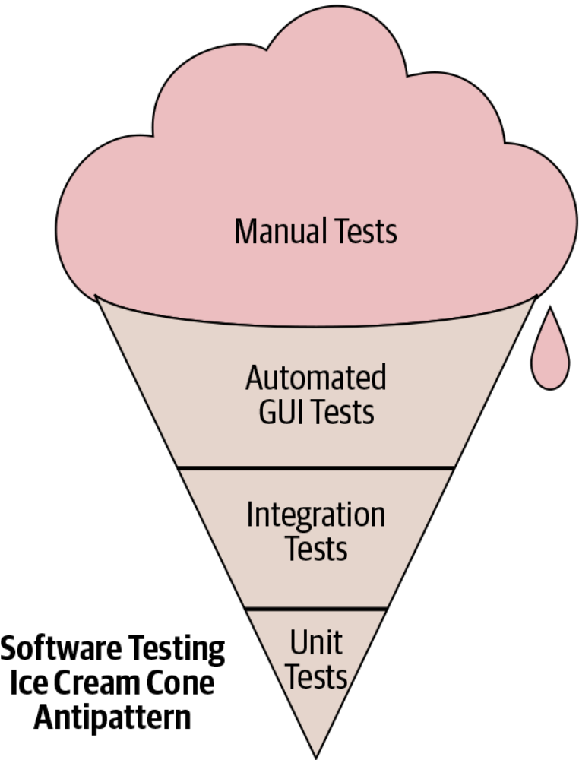
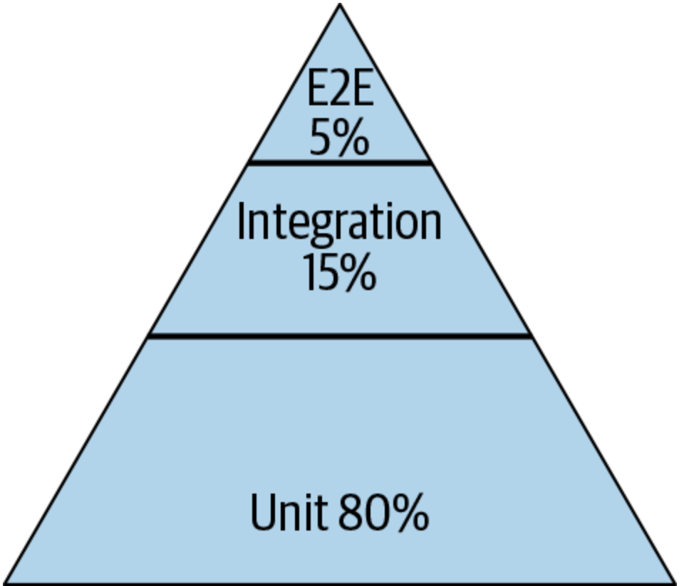
Testing Distribution (How much of each kind of testing we should do?)
Pyramid
Test Pattern
From SoftEng @ Google Chapter 11
https://learning.oreilly.com/library/view/software-engineering-at/9781492082781/ch11.html#testing_overview
Notes:
Typically we talk about this ice cream cone where we have a lot of a lot of manual tests, and then some automatic automated tests specifically related to GUI and then some integration tests and unit tests. The book that we mentioned earlier, software engineering at Google, recommends a different paradigm. It recommends that about 80% of your testing should be focused on unit testing and then about 15% on integration testing and then about 5% on end to end testing (what is known as system level testing).

Slide 20
Integration Tests can be Flaky
Flaky test failures are false alarms
Most common cause of flaky test failures: “async wait” - tests that expect some asynchronous action to occur within a timeout
UI Testing is often flaky and slower
Good tests avoid relying on timing
Good tests avoid relying on the order in which the tests are run
[Luo et al, FSE 2014 “An empirical analysis of flaky tests”]
Notes:
Once tests get to be any bigger than “small”, they may become flaky. UI Testing is often flaky and slower than unit testing
<read slide>

Slide 21
Flaky Test Example: Async/Wait
Most common root cause of flakiness
Difficult to avoid, but there are mitigations:
Have more “small” tests that don’t require concurrency
Ensure sufficient resources available for running tests
Embed reasonable error detection to classify test failures as likely to be “flaky” vs true failures
Start Test
Start server
Wait 3 seconds for server to start
Make request to server
Test fails!
Server startup complete
Too late!
Notes:
The diagram on the right here shows an example of the most typical kind of flaky test, one that is flaky due to an async wait problem.
In this example, a test starts up a server. The server starts up asynchronously. The test waits 3 seconds, assuming that after 3 seconds, the server will have started, and it then makes requests to the server, assuming that it started. However, if the server is late to start, taking MORE than three seconds, then when the test makes its requests to the server, the test will fail – because the server hasn’t started yet.
This is a difficult problem to avoid in general – perhaps the best fix is to write more unit tests (“small” tests that don’t make network connections), avoiding the problem altogether.
Of course, it is impossible to entirely design around this kind of test, because ultimately we need to test the integration of the components. When you have tests that depend on asynchronous things happening within some time bound, it is important to ensure that there are sufficient CPU and RAM available for running the test. This is because timing-dependent tests (like this one) can be more likely to fail due to flakiness when they are starved for resources (and stuff goes slower)
You might also embed reasonable error detection to make it easier to diagnose failures of this test. For example, you might consider making this test check that the server has started BEFORE making any requests, and fail with a specific error if not (e.g. “Error: Server did not complete startup within 3 seconds”).
Increasing the timeout may reduce the occurrence of flaky failures, but it might also result in you missing performance degradations over time. This is a tricky problem to solve.

Slide 22
We make flaky tests anyway
- name: Test that the backend server starts
run: |
npm start -w=server & sleep 5
echo "Checking if home page is served"
curl --fail 'http://localhost:8000/' > /dev/null 2>&1
echo "Checking if login page is served"
curl --fail 'http://localhost:8000/login' > /dev/null 2>&1
echo "Checking if api endpoint returns several threads"
curl --fail 'http://localhost:8000/api/thread/list' 2> /dev/null | jq 'if length < 4 then error("Too few posts returned from api") else . end'

